Slide 1
Puerto Rico Economic Recovery
Overview & Transfer of
COA Prioritization Funding Dependent Decisioning Tool
February 5, 2021

Slide 2
BACKGROUND AND NEED
IRWA:
Facilitate Federal interagency coordination and collaboration
Increase access to recovery funds, reduce duplication, and support fiduciary stewardship
Collaborate with Federal and local partners grantmaking programs
Prevent duplicative investments and/or projects
Ongoing identification of eligible economic recovery and resiliency projects
As per authorization of Recovery Funding, Puerto Rico must demonstrate advancement of COAs and Recovery to Congress
Notes:
The tool presents methods by which GPR may advance COAs and report maximum progress to Congress
In essence, the parties to the Interagencey Work Agreement want us to collaborate, facilitate, prevent duplication and leverage resources to advance recovery!

Slide 3
WHAT WE HAVE DONE
Reviewed obligated funds for federal grants and contracts
Of the six Coordinating Agencies of the NDRF
From September 1, 2017 to December 31, 2020
$43.8 Billion from these six agencies
Economic RSF believes $5.14 Billion applies to 147 COAs
As of this date, only $3.2 billion of the CDBG-DR had been obligated
Does not include the recently obligated $6.2 billion
Notes:
There is some degree of subjectivity to these assumptions. Many recurring and substantial funds, such as Section 8, etc do not align with COAs.

Slide 4
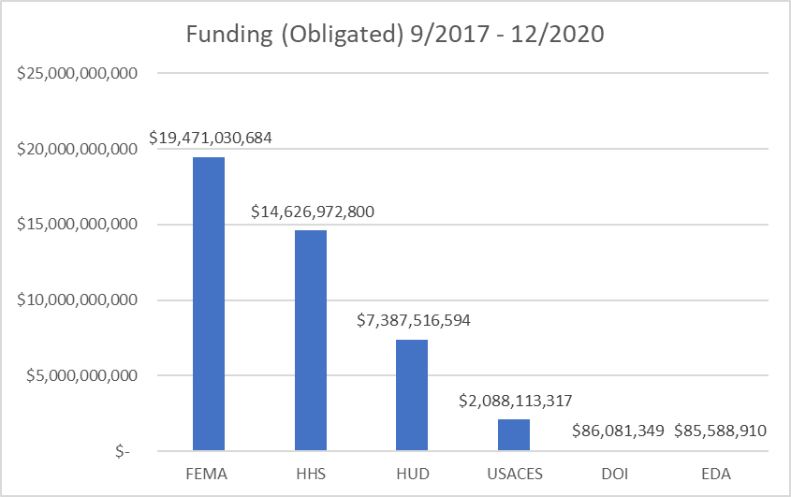
Notes:
FEMA is obligated PA. Looks like there has been an additional $3 B obligated since 1/1/21
All of the $85.5MM obligated from EDA by Juan and Zulma has a nexus with COA/Recovery

Slide 5
SOURCES AND METHODOLOGY
Sources:
USASpending.gov
Grants Manager (FEMA PA)
Only use “Obligated Funds”
Matched Funding to: COAs, Response, COVID-19, & Other
Other is largest category at nearly $31 Billion
For line items having multiple COAs, equal distribution of the obligation among the COAs
Notes:
Trove of information on usaspending.gov
What we turn over to you will be the raw information and downloads (Excel) from the site

Slide 6
Demonstration of Tableau
Funding by Primary Agency
Funding by COA
Funding by Timeline
Notes:
There is some degree of subjectivity to these assumptions

Slide 7
POTENTIAL USES OF THIS TOOL
Evaluate prior grants for alignment with Recovery Goals
Work with other GPR Agencies to minimize risk of de-obligation
Align future and recurring grants with Recovery Goals
Additional data for developing action plans as more CDBG-DR becomes obligated
Guide grant applications and other Federal funding requests
Notes:
Min risk of de-obligation…one thing USAspending tracks is de-obligated funds. They usually show up as negative amounts.
ECON RSF has invested in grant-writing capacity, and the rewards have been amazing. $300k invested.. Based on USAspending, the attendees INCREASED Federal grants received by $75MM

Slide 8
WHAT ARE WE GIVING YOU?
Two Tableau Workbooks
Timeline
Interactive Bar Charts
Backup for all six Coordinating Agencies
Includes the downloads from USASpending.gov
Also includes Economic RSF’s assignment of COAs and other categories to the spending
Notes:
Who is the lucky person I need to email?

Slide 9
QUESTIONS?

